Slide 1
Institute of Technology of Cambodia
Department of information and communication engineering
Automata Theory
Group 09
Lecture: Dr. DONA Valy
Students: SOEM Seakmeng ID: e20201193
POM Mouylang e20201008
PIN Seavmuy e20201618
RORN Makara e20201716
RATHA Sothea e20201208

Slide 2
PROJECT TECHNICAL REPORT
Introduction
Function and Feature
Data Structure
Database Design
Implementation
Result
Conclusion and perspective

Slide 3
Introduction
This project Automata Theory do on Finite automata. This project is to develop an application and manipulate finite automata.

Slide 4
Function and Feature
There are 8 functions
Load FA from file
Create New FA
Convert NFA to DFA
Minimize a DFA
Test if string except by FA
Delete FA file
Update FA file
8. Exit program

Slide 5
Data Structure
We use Link-List for this project.

Slide 6
Database Design
We use text file to store data. Then it show the tables when user input DFA or NFA.

Slide 7
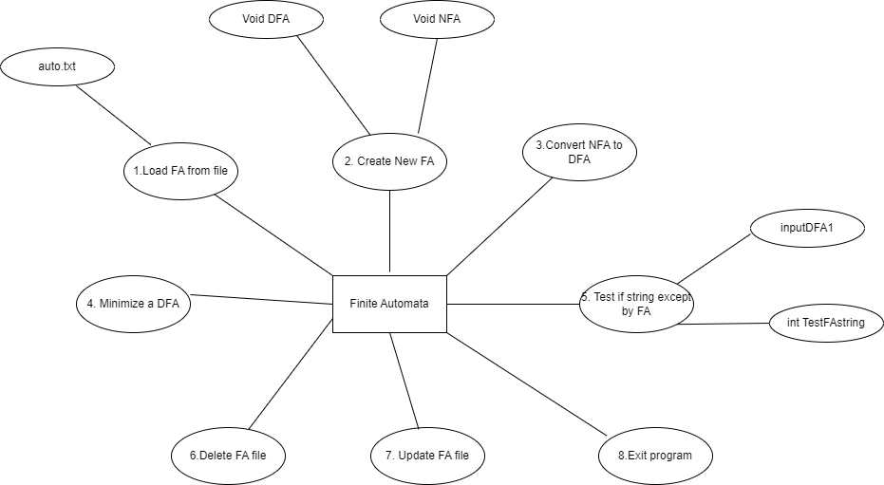
Implementation

Slide 8
Result
We did them all. They have worked.

Slide 9
Conclusion and Perspective
Now it’s is finished. We become much clear about Automata theory. In the future, we hope not to mess up like this.

Slide 10
Demonstration
Test and Run program in Visual Studio Code.

Slide 11
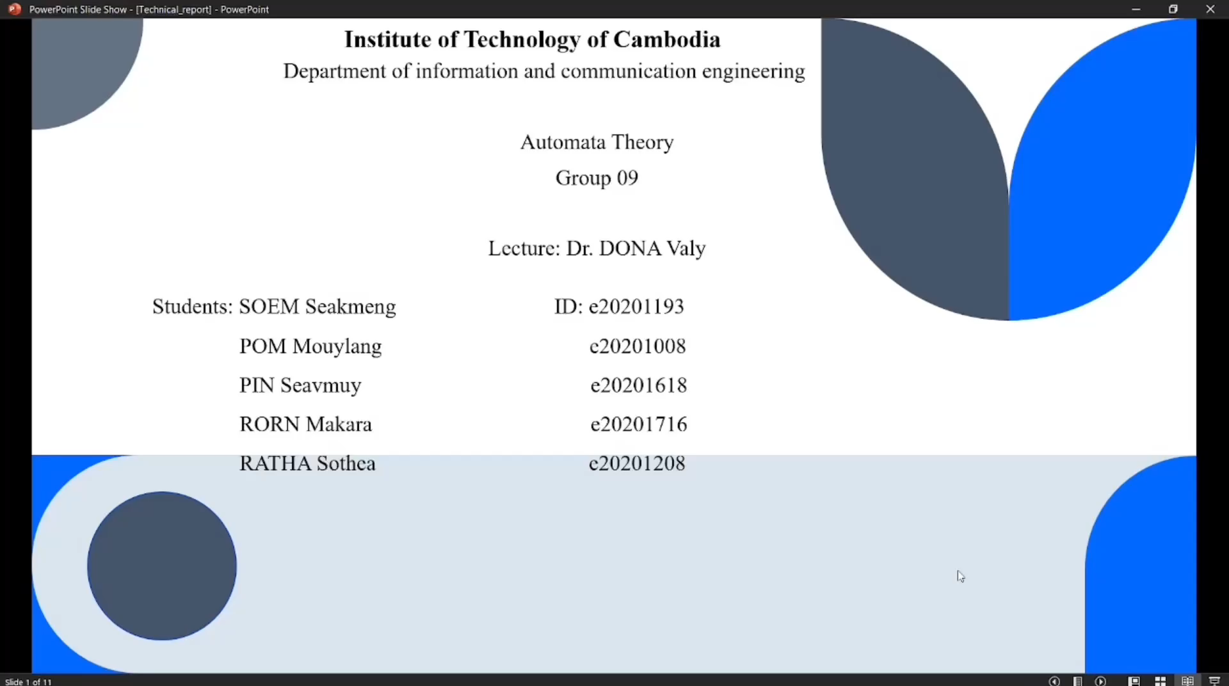

Slide 12
Thank you
Have a nice day

